Slide 1
Object oriented programming - Access Modifiers module 4

Slide 2
Encapsulation is separating what a class does from how it does it.

Slide 3
Encapsulation
public class RightTriangle_v1 {
private double area;
private double base;
private double height;
public RightTriangle_v1(double base,
double height) {
if (base <= 0 || height <= 0) {
this.base = 0;
this.height = 0;
} else {
this.base = base;
this.height = height;
this.area = base * height / 2;
}
}
public double getArea() {
return this.area;
}
}
public class RightTriangle_v2 {
private double base;
private double height;
public RightTriangle_v2(double base,
double height) {
if (base <= 0 || height <= 0) {
this.base = 0;
this.height = 0;
} else {
this.base = base;
this.height = height;
}
}
public double getArea() {
return this.base * this.height / 2;
}
}

Slide 4
Encapsulación
public class EncapsulationDemo {
public static void main(String[] args) {
RightTriangle_v1 triangle1 = new RightTriangle_v1(10, 5);
RightTriangle_v2 triangle2 = new RightTriangle_v2(10, 5);
double out1 = triangle1.getArea();
double out2 = triangle2. getArea();
System.out.println("Class V1: " + out1);
System.out.println("Class V2: " + out2);
}
}
getArea() in both implementations produces the same results

Slide 5
How do you achieve encapsulation?
Through access modifiers
Public methods to interact with the class

Slide 6
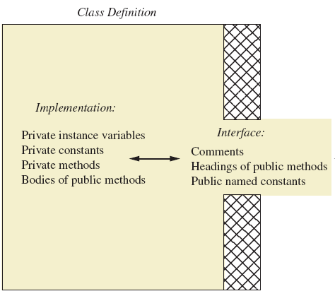
Programmer who uses the class

Slide 7
Access Modifiers
An access modifier limits the scope of a variable, method or class. There are 4 access modifiers in java, but the most common are private and public.

Slide 8
Getter
The getter method, also known as accessor, is a type of method that allows you to read the contents of an instance variable in a class.
public class RightTriangle_v1 {
//...
//rest of the variables and methods
//...
private double height;
public double getHeight() {
return this.height;
}
}
Note that height is a private variable, hence it is impossible to read its contents directly from outside the class. That is what the public getHeight() method is used for

Slide 9
Setter
Setter methods, also known as mutator, allows you to modify the contents of an instance variable in a class.
public class RightTriangle_v1 {
//...
//rest of the variables and methods
//...
private double height;
private double area;
public void setHeight(double height) {
if (height > 0) {
this.height = height;
this.area = this.base * this.height / 2;
}
}
}
If height is modified, then we should modify the contents of variable area too.
This internal congruency can be achieved through the setter method setHeight( ).

Slide 10
It is a good practice to declare all instance variables as private, and use setter and getter methods to interact with them.

Slide 11
public class RightTriangle_v1 {
private double area;
private double base;
private double height;
public RightTriangle_v1(double base,
double height) {
if (base <= 0 || height <= 0) {
this.setBase(0);
this.setHeight(0);
} else {
this.setBase(base);
this.setHeight(height);
}
}
private void updateArea() {
this.area = this.getBase() * this.getHeight() / 2;
}
public double getBase() {
return this.base;
}
public void setBase(double base) {
if (base >= 0) {
this.base = base;
this.updateArea();
}
}
public double getHeight() {
return this.height;
}
public void setHeight(double height) {
if (height >= 0) {
this.height = height;
this.updateArea();
}
}
public double getArea() {
return this.area;
}

Slide 12
private void updateArea() {
this.area = this.getBase() * this.getHeight() / 2;
}
Why is updateArea() a private method?
When we use instance variable area, we expect its contents to be updated and congruent with the rest of its attributes. The class code is responsible to guarantee that updateArea() is called every time one of its dimensions are changed.

Slide 13
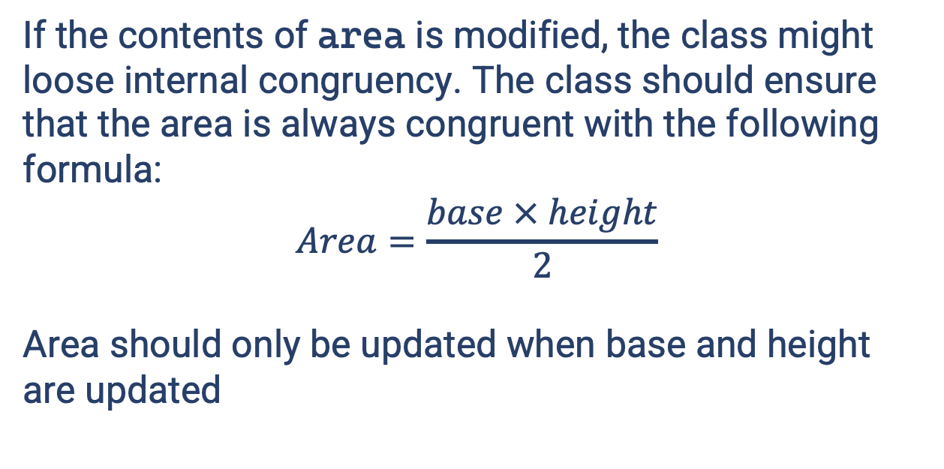
Why don’t we create a setArea() method?
If the contents of area is modified, the class might loose internal congruency. The class should ensure that the area is always congruent with the following formula:
$$Area=\frac{base × height}{2}$$
Area should only be updated when base and height are updated

